Slide 1
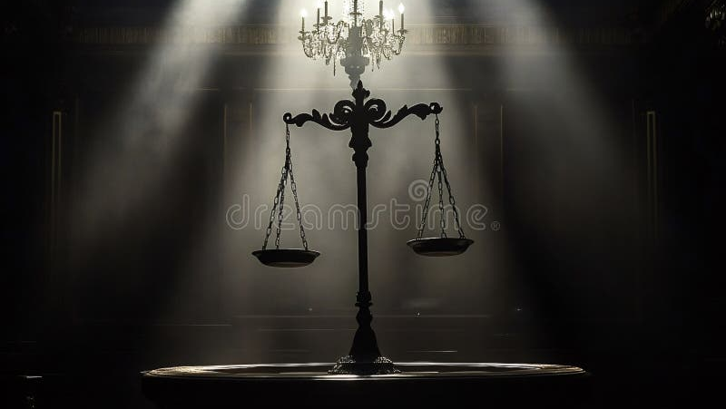
A YOUNG LAW STUDENT'S ANALYSIS
THIS TRIAL
SHOULD BE A MISTRIAL!
The Karmelo Anthony Case — Why Justice Was NOT Served
Examining the Evidence, the Bias, and the Constitutional Violations
⚖️ JUSTICE FOR KARMELO ⚖️

Slide 2
📁 MY CASE FILES
01
What Happened?
02
THE PHOTO
03
What is a Mistrial?
The background of the Karmelo Anthony case and what went down at that track meet.
The photo that could prove everything. Exhibit A in our case for a mistrial.
Learn what a mistrial is and when courts are REQUIRED to declare one.
04
Why This is Bias
05
The Jury Problem
06
DEMAND JUSTICE
How conflicts of interest destroy the fairness of a trial. The law is CLEAR.
Why an all-white jury in this case is a serious problem for justice.
What we can do and why Karmelo Anthony deserves a FAIR retrial.
02

Slide 3
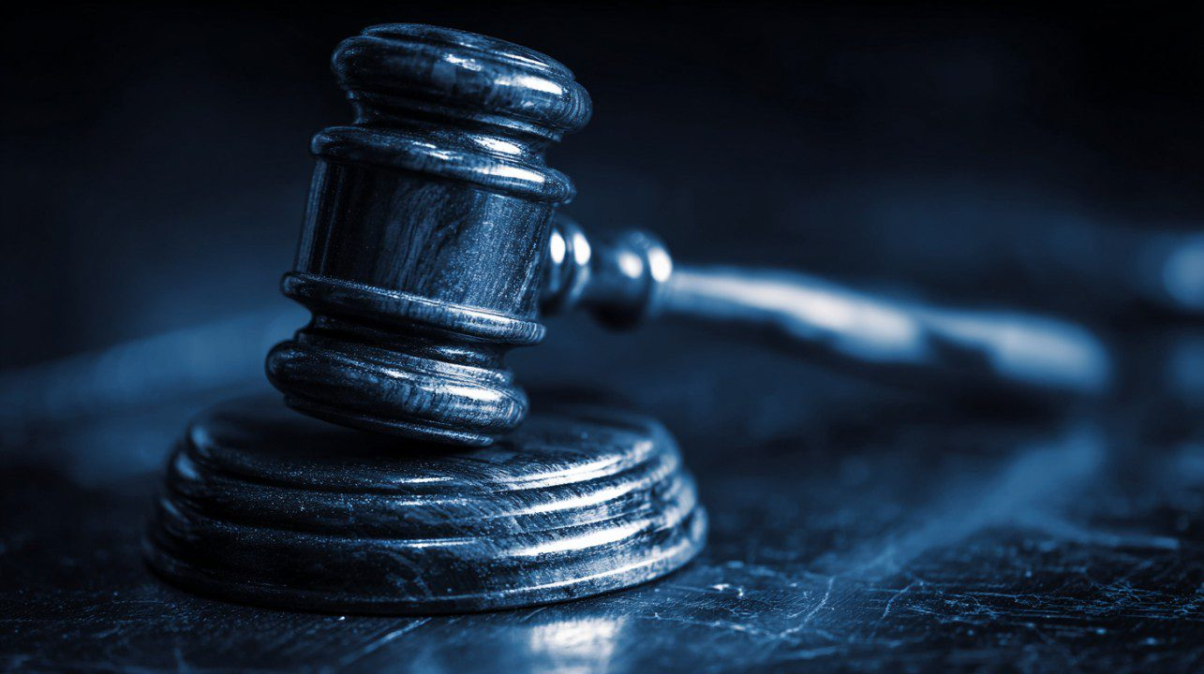
⚖️ JUSTICE FOR KARMELO
The Case That Shocked Texas
April 2, 2025
At a track meet in Frisco, Texas, 17-year-old Karmelo Anthony fatally stabbed fellow student Austin Metcalf.
Karmelo claimed he acted in self-defense during an altercation. Witnesses say Austin touched/grabbed Karmelo first.
In June 2026, Karmelo was sentenced to 35 years in prison.
Case Timeline
Apr 2025
Incident at track meet
Jun 2025
Indicted by grand jury
Jul 2025
Gag order issued
Jun 2026
Trial begins
Jun 2026
35-year sentence
35 YEARS
for a 17-year-old claiming self-defense
03

Slide 4
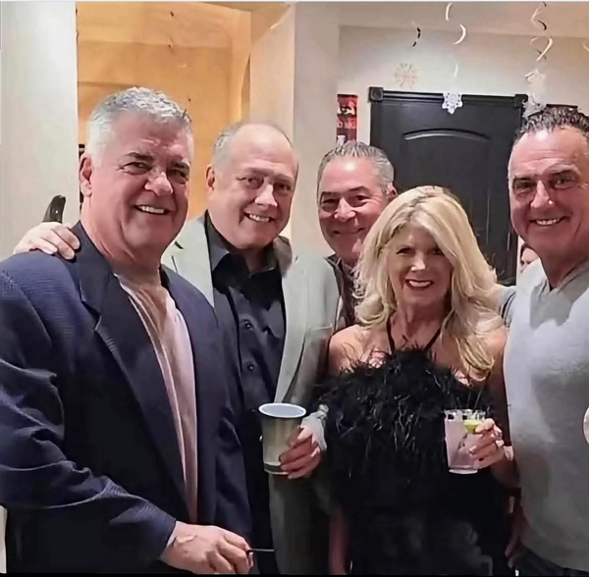
EXHIBIT A
The Photo That Changes EVERYTHING
Jeff Metcalf (Victim's Dad)
Alleged: Judge John Roach
Alleged: DA Greg Willis
WHY THIS MATTERS
If the judge and DA were socializing with the victim's father, they should have been REMOVED from this case.
This is NOT about guilt or innocence. This is about FAIRNESS.
04

Slide 5
⚖️ JUSTICE FOR KARMELO
What Even IS a Mistrial?
LEGAL DEFINITION
THE CONSTITUTION SAYS...
A mistrial is when a trial is cancelled and must start over because something went seriously wrong that prevented a fair trial.
Grounds for a Mistrial:
"In all criminal prosecutions, the accused shall enjoy the right to a speedy and public trial, by an impartial jury..."
— Sixth Amendment, U.S. Constitution
Judicial misconduct — judge did something improper
Conflict of interest — bias or personal connections
Hung jury — jury cannot agree on a verdict
Improper evidence — evidence that shouldn't be admitted
Every defendant has the RIGHT
to an IMPARTIAL judge and jury!
Jury tampering — outside influence on jurors
05

Slide 6
⚖️ JUSTICE FOR KARMELO
CONFLICT OF INTEREST = Broken Justice
TEXAS LAW
HOW THIS APPLIES HERE
Code of Judicial Conduct
Canon 3B(1)
Judge John Roach allegedly socialized with Jeff Metcalf (victim's father) at a gathering
Judges must disqualify themselves from any proceeding in which their impartiality might reasonably be questioned.
It's not about proving bias — it's about the APPEARANCE of bias.
This creates an appearance of bias — the judge may feel sympathy for the victim's family
WHAT IS RECUSAL?
Recusal means a judge or prosecutor steps down from a case because they have a conflict of interest. It's required by law when personal relationships could affect fairness.
Result: Judge should have REMOVED HIMSELF from the case. Failure to do so = grounds for mistrial.
"Justice must not only be done, but must also be seen to be done." — Lord Hewart, 1924
06

Slide 7
⚖️ JUSTICE FOR KARMELO
Due Process Was VIOLATED
The Fourteenth Amendment guarantees due process of law. Here are the violations in Karmelo's trial:
1
Judge's Social Ties
2
DA Connections
3
All-White Jury
Judge Roach allegedly had a social relationship with the victim's father, Jeff Metcalf. This creates an appearance of bias that violates judicial ethics.
DA Greg Willis may have had improper connections to the Metcalf family. The prosecution's objectivity is compromised if they socialize with the victim's family.
An all-white jury was selected for a case with significant racial elements. Studies show diverse juries make better decisions. This is a Batson violation concern.
4
Gag Order Limitations
5
Toxic Public Atmosphere
Judge Roach issued a gag order in July 2025 that limited the defense's ability to respond to public accusations while the prosecution and media could shape public opinion freely.
Social media was flooded with misinformation — fake autopsy reports, AI-generated images, false narratives. Finding an impartial jury became nearly impossible.
07

Slide 8
⚖️ JUSTICE FOR KARMELO
The All-White Jury Problem
0%
What Research Shows:
Diverse juries deliberate longer and consider more evidence
Black Jurors
Diverse juries make fewer factual errors and recall testimony better
The jury that convicted Karmelo Anthony had zero Black jurors in a case with significant racial tensions.
Diverse juries are more likely to question assumptions and biases
All-white juries are more likely to convict Black defendants
Batson v. Kentucky (1986)
The Supreme Court ruled that prosecutors CANNOT use peremptory challenges to exclude jurors based on race. This is called a Batson challenge.
If the defense can show a pattern of striking minority jurors, the prosecution must give a race-neutral reason. If they can't, those jurors must be seated.
Question: Were minority jurors improperly excluded from Karmelo's jury?
08

Slide 9
⚖️ JUSTICE FOR KARMELO
The Public Was Manipulated
Before the trial even started, misinformation flooded social media and poisoned the jury pool:
FAKE Autopsy Report
AI-Generated Images
Fake Police Accounts
A fabricated autopsy report surfaced on Facebook, falsely claiming drugs were involved in the incident. Pure fiction designed to smear Karmelo.
AI-generated images of Karmelo crying in court and other fake courtroom photos were spread to manipulate public emotion.
A fake X account posing as the Frisco Police Chief spread fabricated details about the investigation to millions of people.
THE REAL IMPACT
High-profile accounts got 50 MILLION views on early posts
Both families received swatting calls and death threats
Judge admitted "unconscious bias" is real — yet proceeded
Finding an impartial jury became nearly impossible
Extra security needed at Austin Metcalf's funeral
The gag order silenced defense while misinformation spread
09

Slide 10
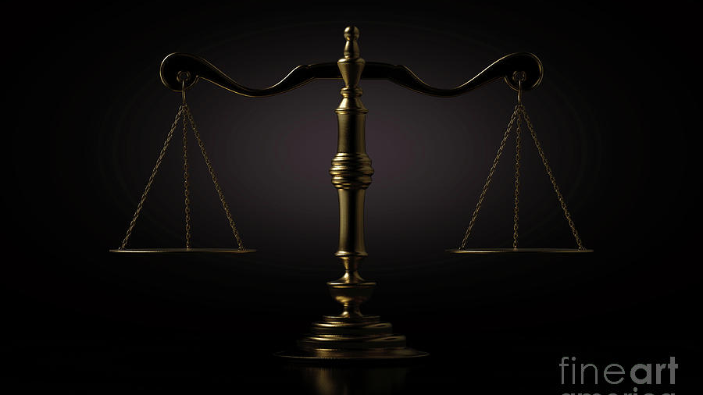
JUSTICE FOR KARMELO!
Every person deserves a fair trial with an impartial judge and unbiased jury.
The evidence of potential conflicts of interest cannot be ignored.
This trial should be declared a MISTRIAL
and Karmelo Anthony deserves a FAIR RETRIAL.
"The Constitution guarantees it. The Sixth Amendment demands it. Justice requires it."
#JusticeForKarmelo #Mistrial #FairTrial

